Slide 1
Learning Objective
I will be able to describe the transformations af(x) and f(bx)
Success Criteria
At the end of the lesson, I will be able to:
define what it means for a function to dilate parallel to an axis;
apply an understanding of the graphs of functions to generalise and describe the transformations af(x) and f(bx);
solve algebraic problems involving dilations; and
recognise the conditions for a reflection about the axes.

Slide 2
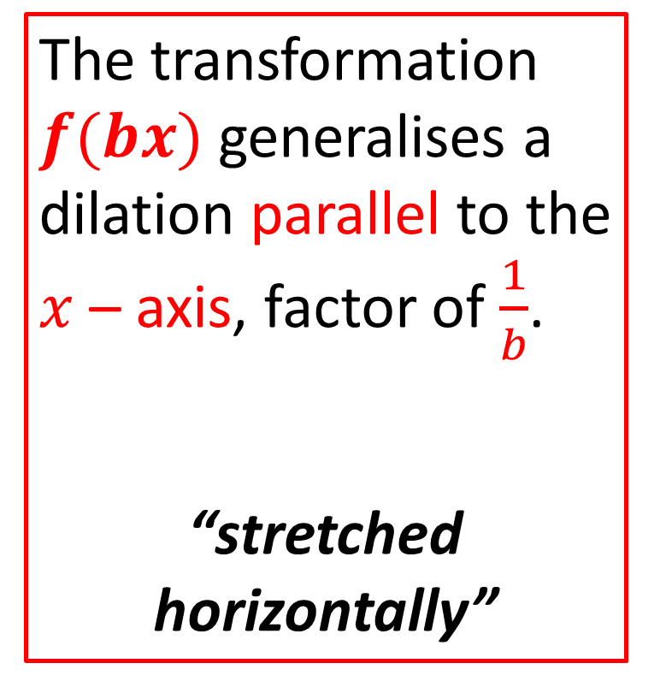
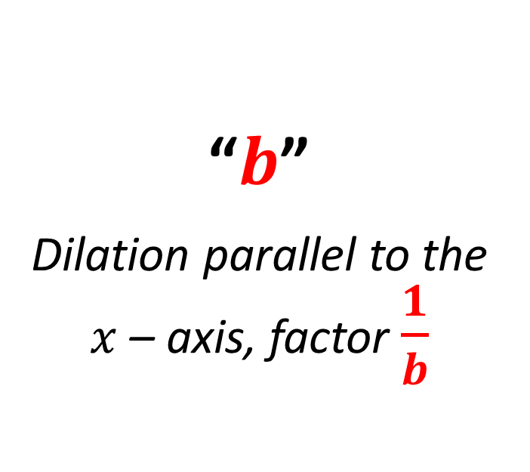
Horizontal Dilation
Concept Development
The transformation $f(bx)$ generalises a dilation parallel to the $x$ – axis, factor of $\frac{1}{b}$.
“stretched horizontally”
“$b$”
Dilation parallel to the $x$ – axis, factor $\frac{1}{b}$

Slide 3
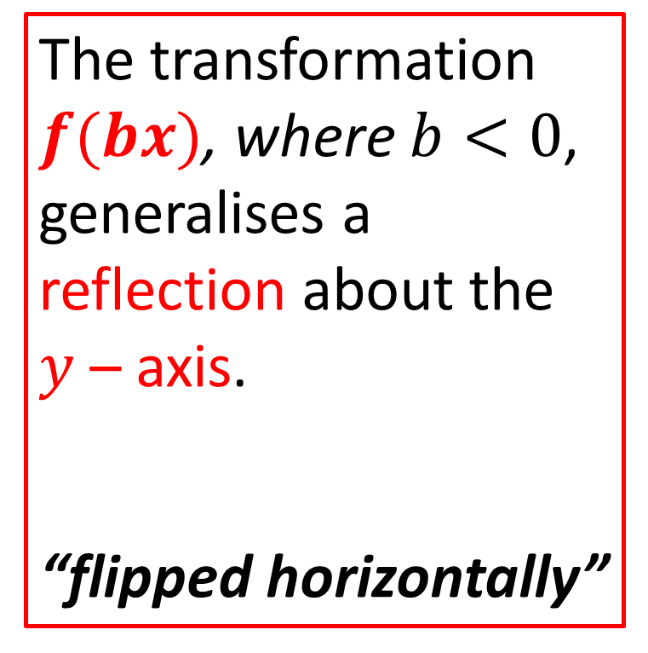
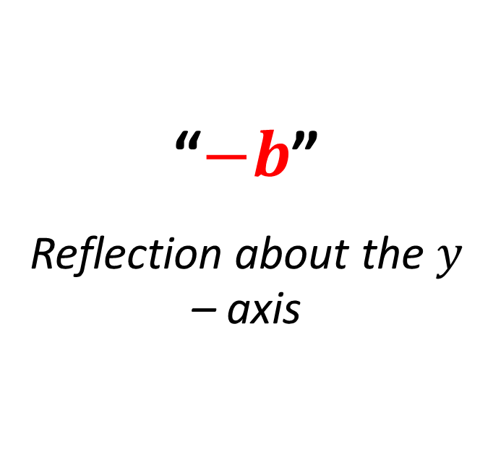
Horizontal Reflection
Concept Development
The transformation $f(bx)$, where $b<0$, generalises a reflection about the $y$ – axis.
“flipped horizontally”
“$−b$”
Reflection about the $y$ – axis

Slide 4


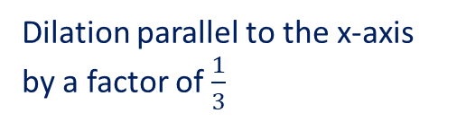


Guided Practice
Describe the transformations that have occured from:
Describe the transformations that have occured from:
$$f\left(x\right)→f\left(\frac{1}{2}x\right)$$
$−$ve: Reflection about the $y−$axis
Dilation parallel to the x-axis by a factor of $\frac{1}{3}$
Dilation parallel to the x-axis by a factor of 2

Slide 5


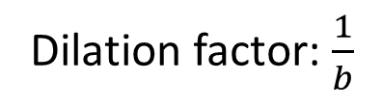



Terminology $f\left(x\right)→f(bx)$
Concept Development
Dilation factor: $\frac{1}{b}$
Parallel to the $x−$axis
Along the $x−$axis
In the $x−$axis
From the $y−$axis

Slide 6
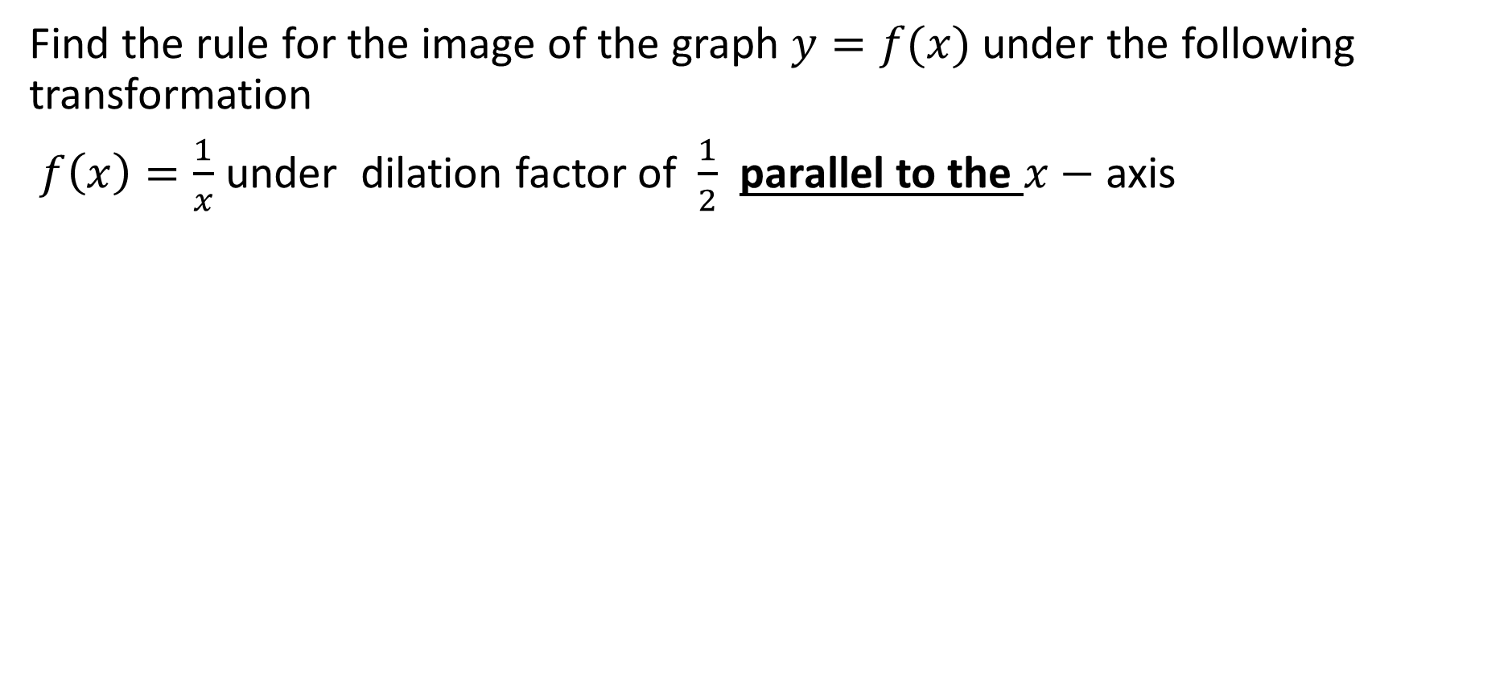
Guided Practice
Find the rule for the image of the graph $y=f(x)$ under the following transformation
$f\left(x\right)=\frac{1}{x}$ under dilation factor of $\frac{1}{2}$ parallel to the $x−$ axis

Slide 7
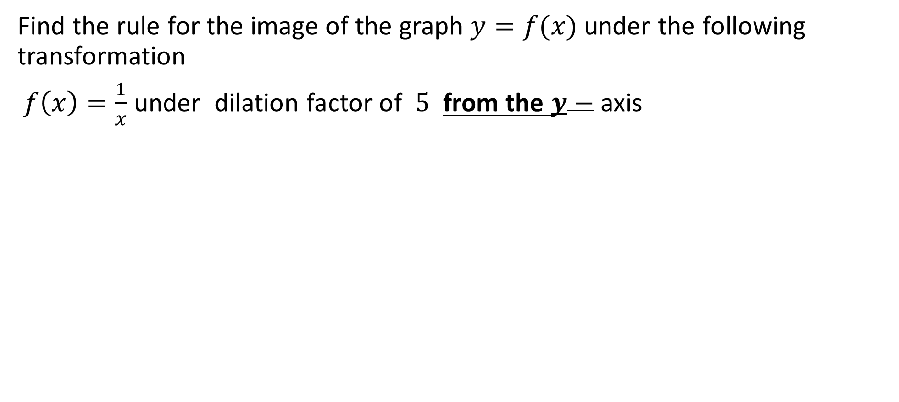
Guided Practice
Find the rule for the image of the graph $y=f(x)$ under the following transformation
$f\left(x\right)=\frac{1}{x}$ under dilation factor of $5$ from the $y−$ axis

Slide 8
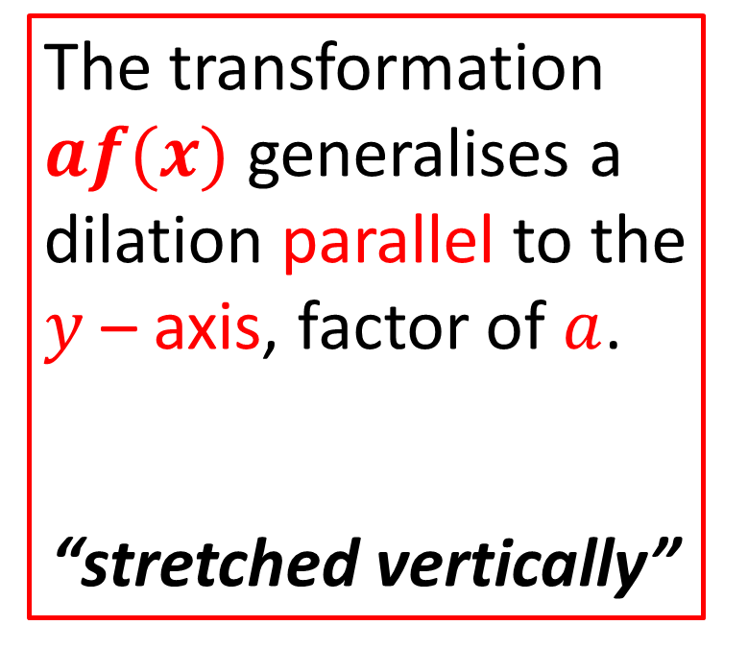
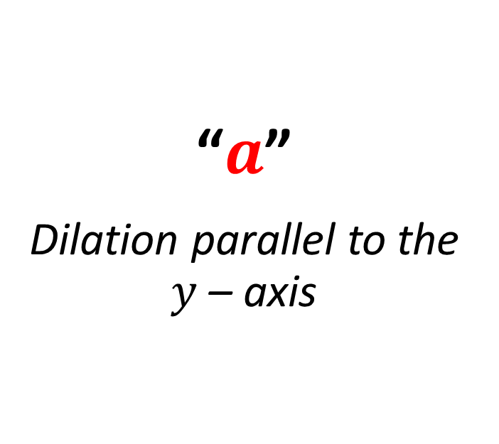
Vertical Dilation
Concept Development
The transformation $af(x)$ generalises a dilation parallel to the $y$ – axis, factor of $a$.
“stretched vertically”
“$a$”
Dilation parallel to the $y$ – axis

Slide 9
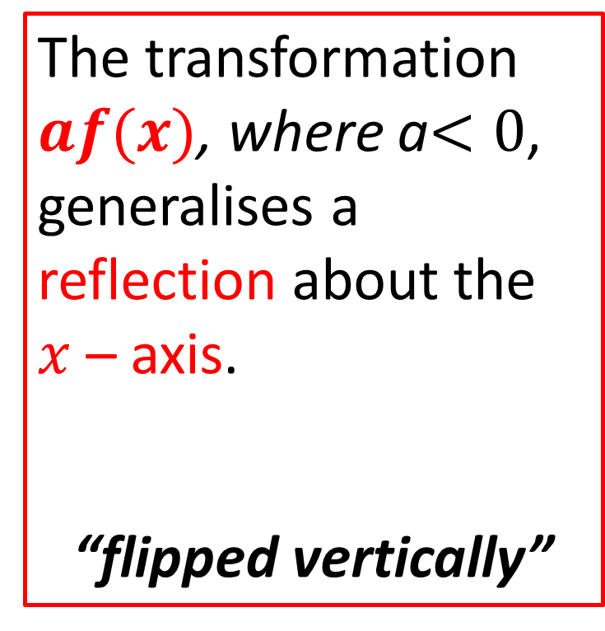
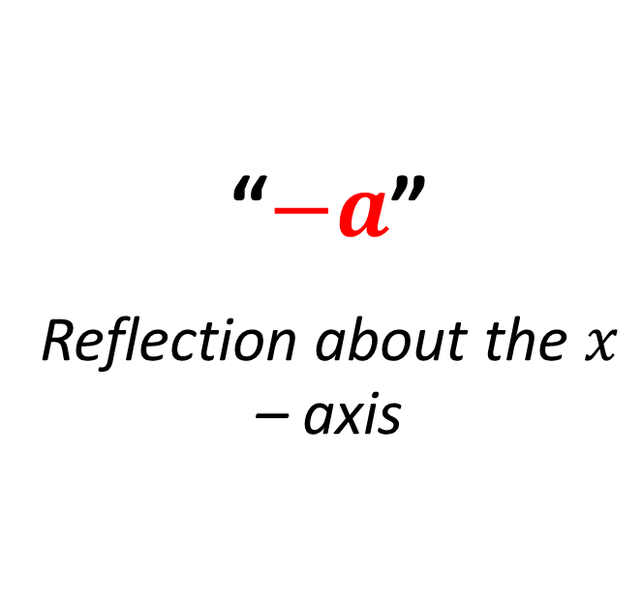
Vertical Reflection
Concept Development
The transformation $af(x)$, where a$<0$, generalises a reflection about the $x$ – axis.
“flipped vertically”
“$−a$”
Reflection about the $x$ – axis

Slide 10
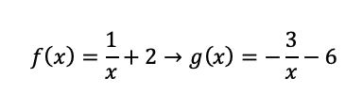





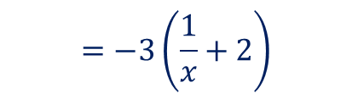
Guided Practice
Describe the transformations that have occured from:
Describe the transformations that have occured from:
$$g\left(x\right)=−\left(\frac{3}{x}+6\right)$$
$−$ve: Reflection about the $x−$axis
$$=−3\left(\frac{1}{x}+2\right)$$
Dilation parallel to the y-axis
by a factor of 5
$$=−3f(x)$$
$−$ve: Reflection about the $x−$axis
Dilation parallel to the y-axis
by a factor of 3

Slide 11






Terminology $f\left(x\right)→af(x)$
Concept Development
Dilation factor: $a$
Parallel to the $y−$axis
Along the $y−$axis
In the $y−$axis
From the $x−$axis

Slide 12
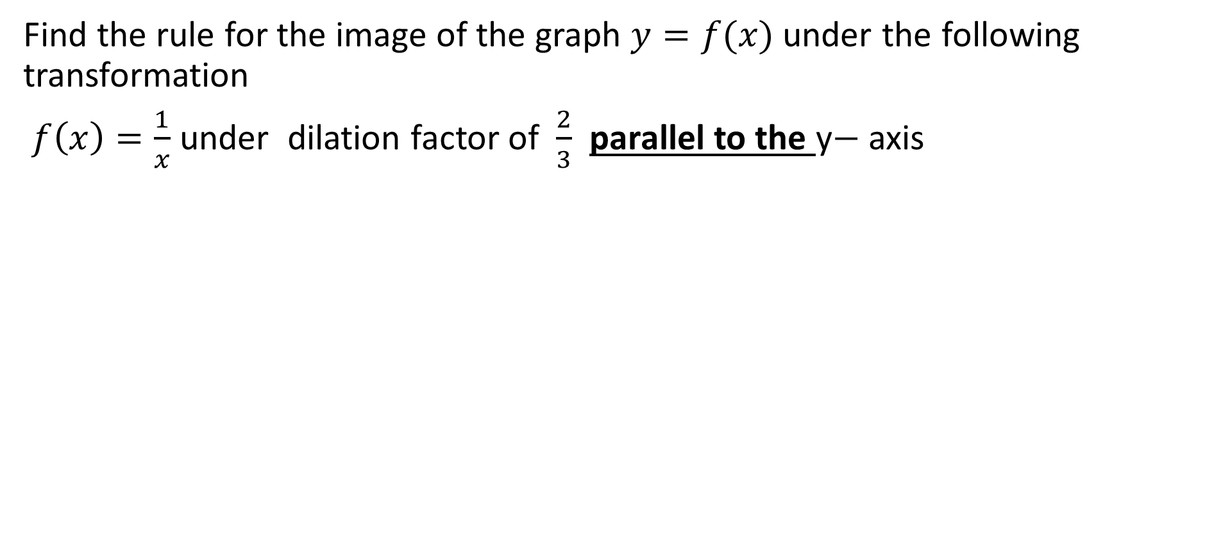
Guided Practice
Find the rule for the image of the graph $y=f(x)$ under the following transformation
$f\left(x\right)=\frac{1}{x}$ under dilation factor of $\frac{2}{3}$ parallel to the y$−$ axis

Slide 13
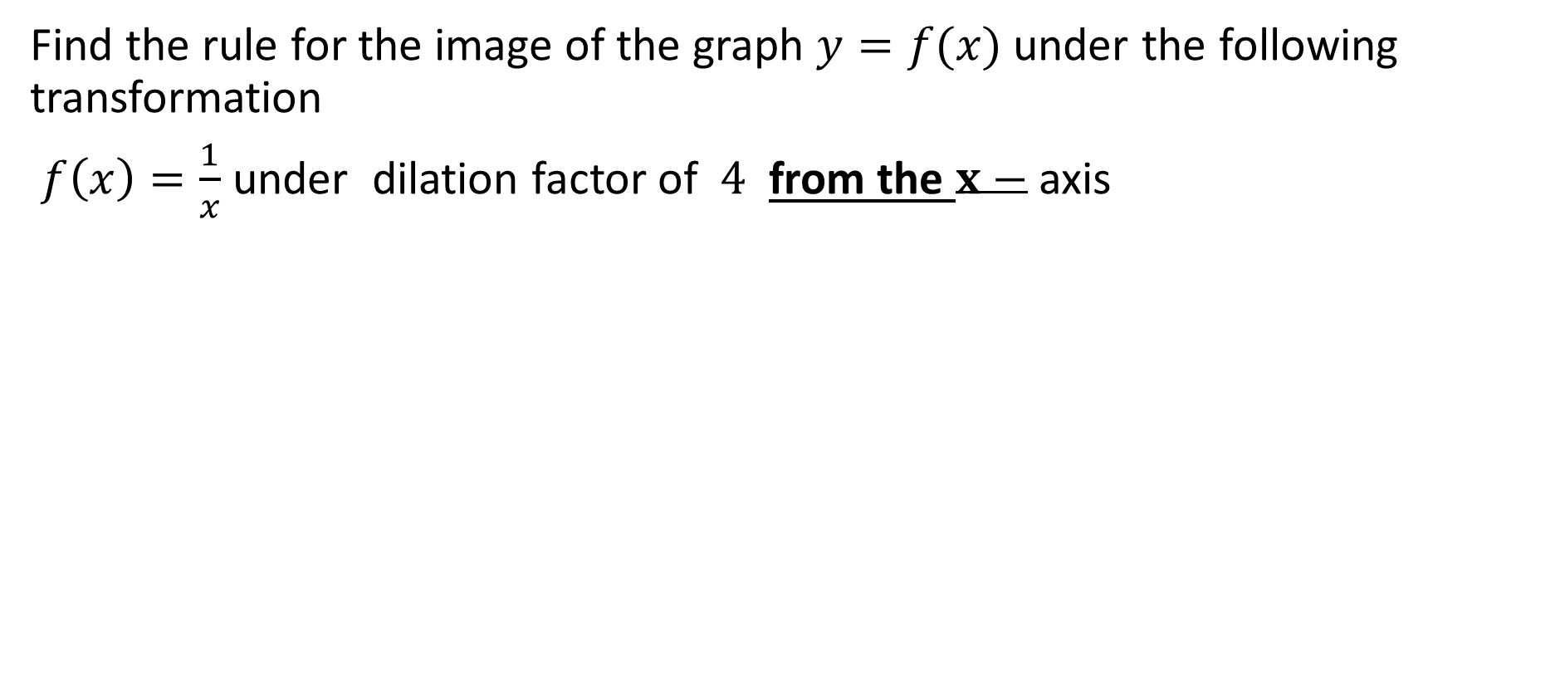
Guided Practice
Find the rule for the image of the graph $y=f(x)$ under the following transformation
$f\left(x\right)=\frac{1}{x}$ under dilation factor of $4$ from the $x−$ axis

Slide 14
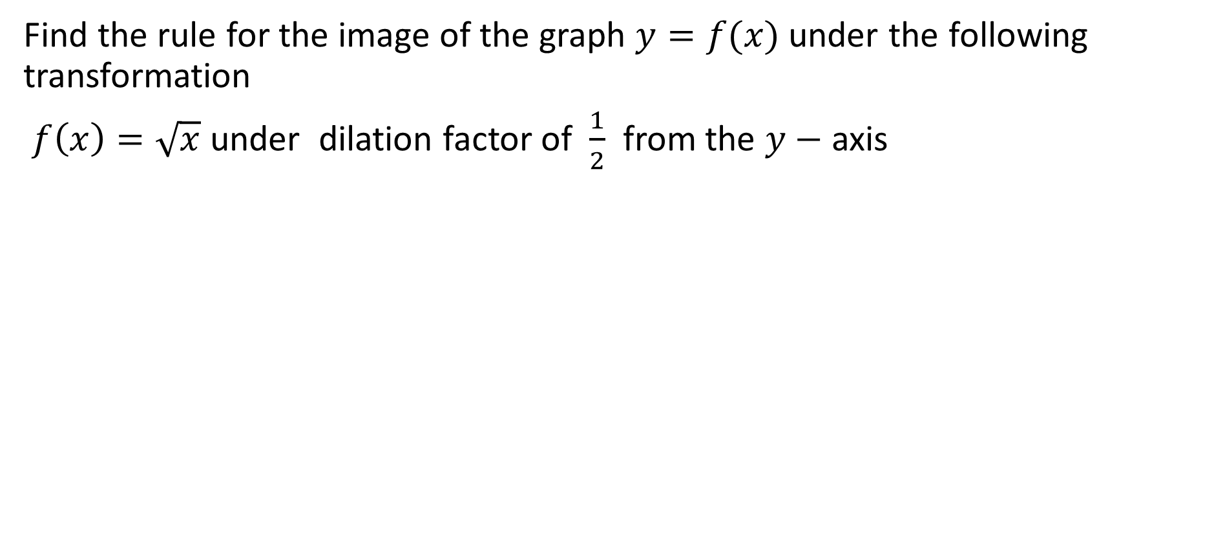
Guided Practice
Find the rule for the image of the graph $y=f(x)$ under the following transformation
$f\left(x\right)=\sqrt{x}$ under dilation factor of $\frac{1}{2}$ from the $y−$ axis

Slide 15
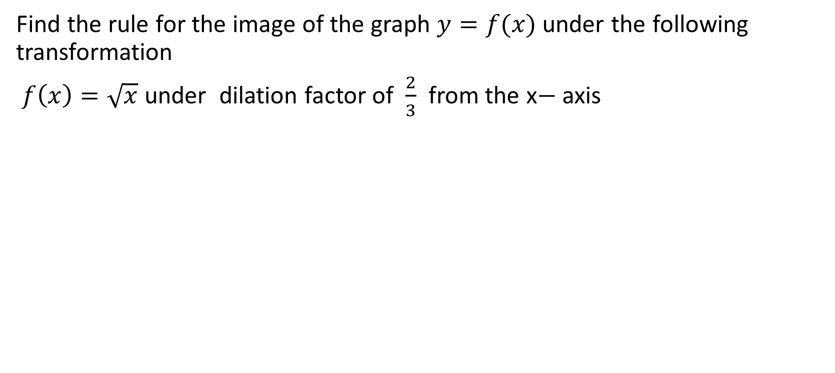
Guided Practice
Find the rule for the image of the graph $y=f(x)$ under the following transformation
$f\left(x\right)=\sqrt{x}$ under dilation factor of $\frac{2}{3}$ from the x$−$ axis

Slide 16
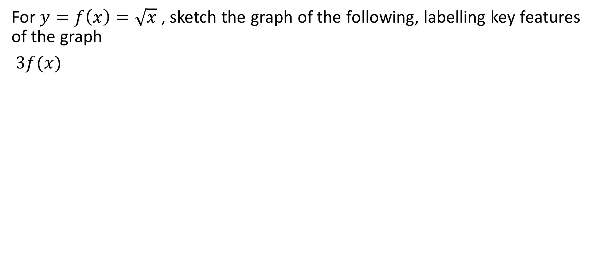
Guided Practice
For $y=f\left(x\right)=\sqrt{x}$ , sketch the graph of the following, labelling key features of the graph
$3f(x)$

Slide 17
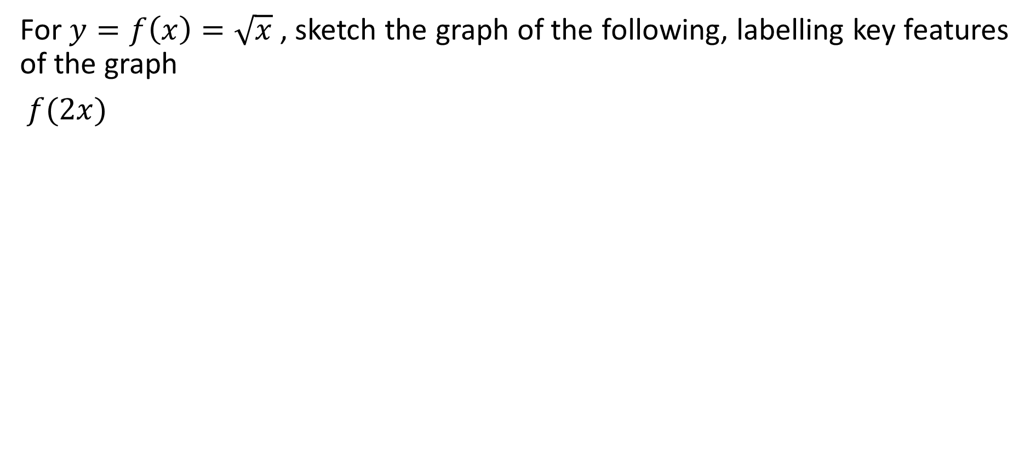
Guided Practice
For $y=f\left(x\right)=\sqrt{x}$ , sketch the graph of the following, labelling key features of the graph
$f(2x)$

Slide 18



Guided Practice
Find the image of the point (-2, -3) after:
A reflection in the x-axis
A reflection in the y-axis
A dilation of factor 4 from the x-axis
A dilation of factor 4 from the y-axis
a) $\left(−2,−3\right)→\left(−2,3\right)$
b) $\left(−2,−3\right)→\left(2,−3\right)$
c) $\left(−2,−3\right)→\left(−2,−3×4\right)=(−2,−12)$
d) $\left(−2,−3\right)→\left(−2×4,−3\right)=(−8,−3)$

Slide 19
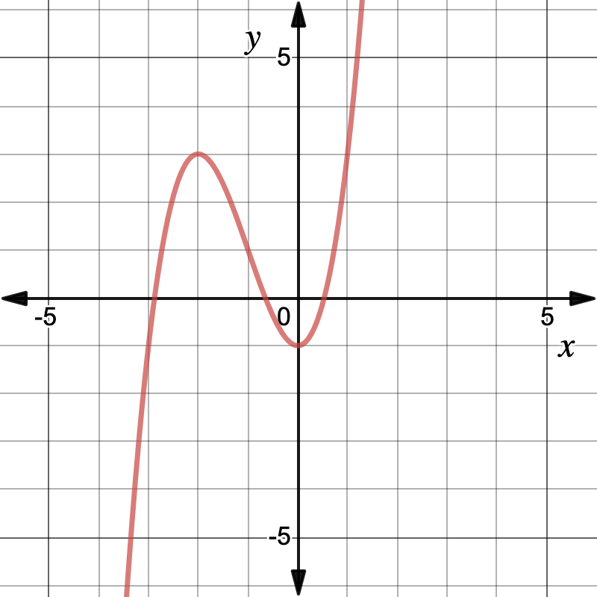
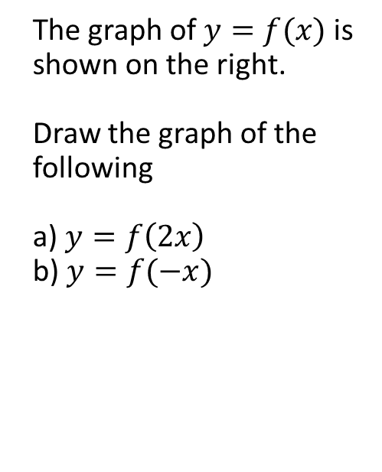

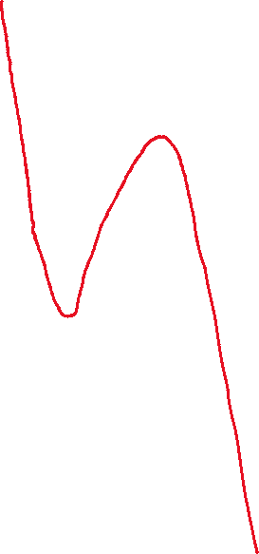
Guided Practice
The graph of $y=f(x)$ is shown on the right.
Draw the graph of the following
a) $y=f\left(2x\right)$
b) $y=f(−x)$

Slide 20
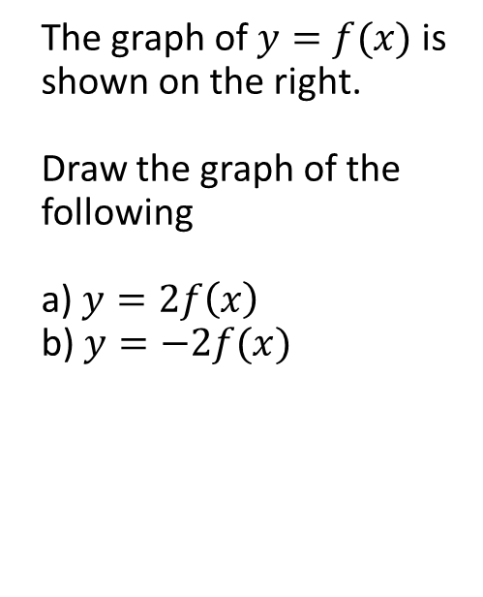
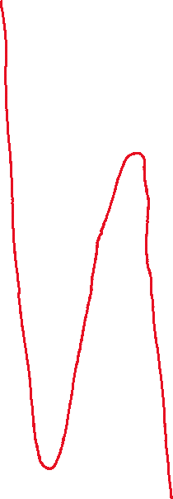
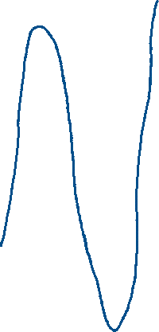
Guided Practice
The graph of $y=f(x)$ is shown on the right.
Draw the graph of the following
a) $y=2f\left(x\right)$
b) $y=−2f(x)$

Slide 21
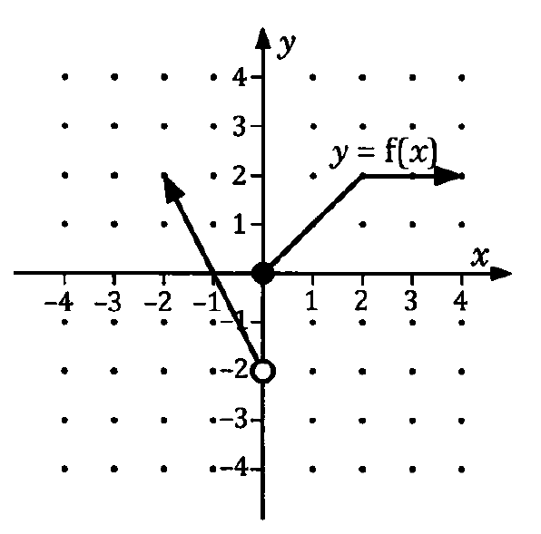
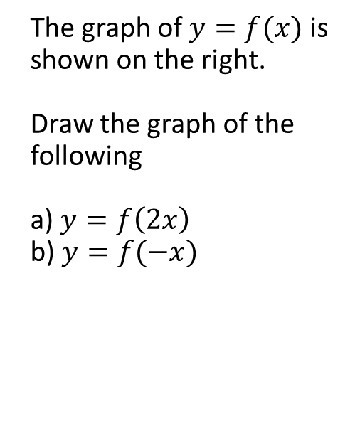
Guided Practice
The graph of $y=f(x)$ is shown on the right.
Draw the graph of the following
a) $y=f\left(2x\right)$
b) $y=f(−x)$

Slide 22
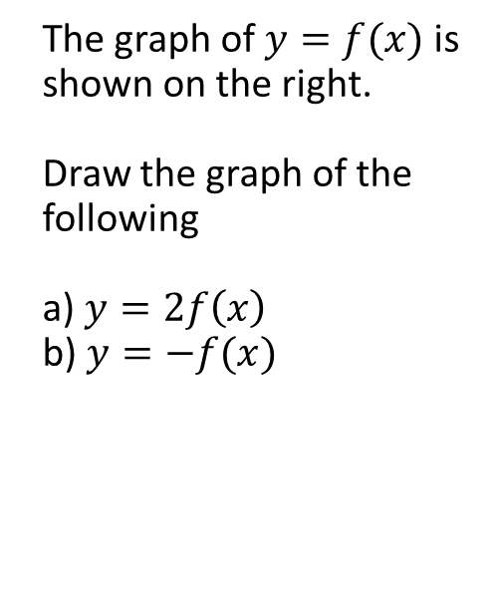
Guided Practice
The graph of $y=f(x)$ is shown on the right.
Draw the graph of the following
a) $y=2f\left(x\right)$
b) $y=−f(x)$

Slide 23
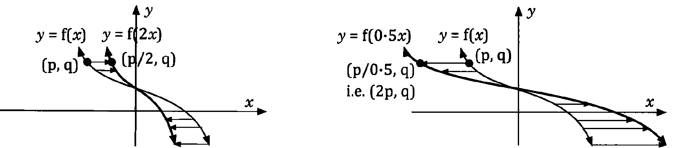
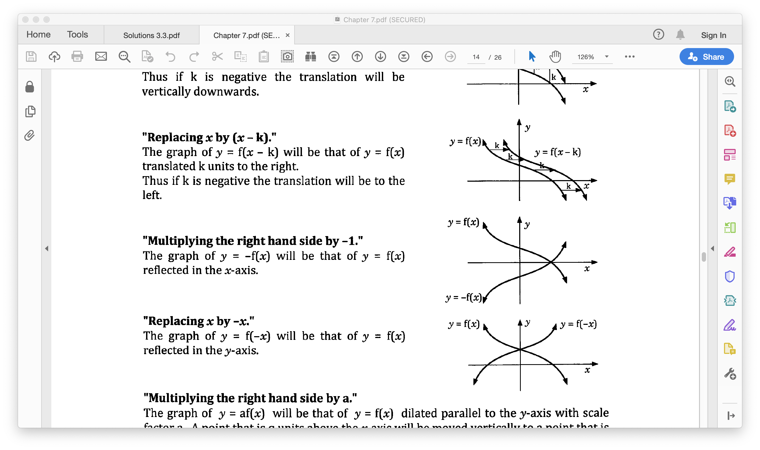
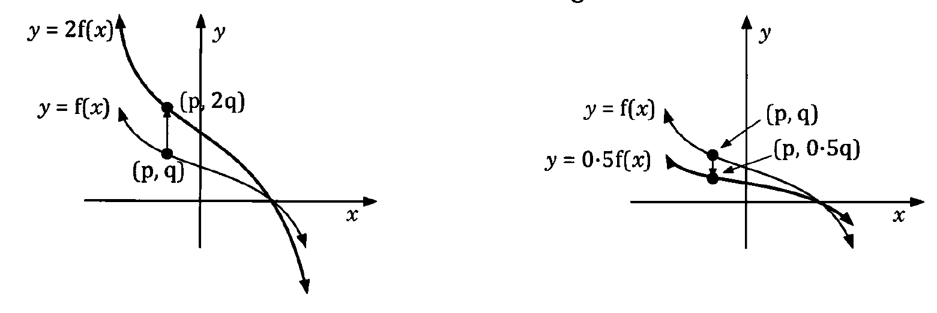





Summary
HORIZONTAL
$$f(bx)$$
Dilation
$$f(−bx)$$
Reflection
$$f(x)$$
VERTICAL
$$af(x)$$
Dilation
$$−af(x)$$
Reflection

Slide 24
Independent Practice
Complete Cambridge Ex 6G

